Slide 1
Lalitha Priya Bhupalam
Mehdi Naderi Varandi
Yavor Edipov
James Craster
Oluwafemi Oladipo
Iurii Maksymets
Autistica Challenge
Team 21

Slide 2
Aim
Automate
Automate the resources and steps needed for a longitudinal study
Create
Create great user experience
Provide
Provide critical insights to researchers and employers

Slide 3
Difficult to Reach more people
Misdiagnoses can occur due to lack of understanding/studies done solely on men
Challenges for the Client

Slide 4
Live Tech Demo
Show login
Show some questions be answered
Show the garden
Explain the impact
Show possibly the NLP

Slide 5
Easily accessible by anyone, on any device
Simple and easy to use
Extremely customizable – suits any users needs
Provides immediate insight
Allows researcher/employer to customise and add new questions
Benefits and advantages of our solution

Slide 6
Roadmap
In the future, we can:
Leverage NLP to provide insights about qualitative data
Most of the work on this is done already!
Provide more buttons like the ability to skip
Make solution even more accessible for others e.g. deaf, blind
Improve gameplay feedback system

Slide 7
How do we meet the judging criteria?
Fit to NGO Challenge/Need | Fully meet the clients needs and requirements. We leverage existing technologies and knowledge of psychology to ensure that users are consistently engaged.
Level of Innovation | We utilise knowledge of psychology/reward mechanisms to ensure that users are motivated to use our application.
Quality of Pitch | It’s going good so far, right?
Completeness of Solution | Roadmap is presented and fully detailed. We have also polished our solution to easily allow client to expand on it in the future.
Sustainability/Feasibility | Already running – our demonstration is a real life example of how it works, not just a proof of concept. Solution is ready to be developed further by the NGO, and is fully financially sustainable.

Slide 8
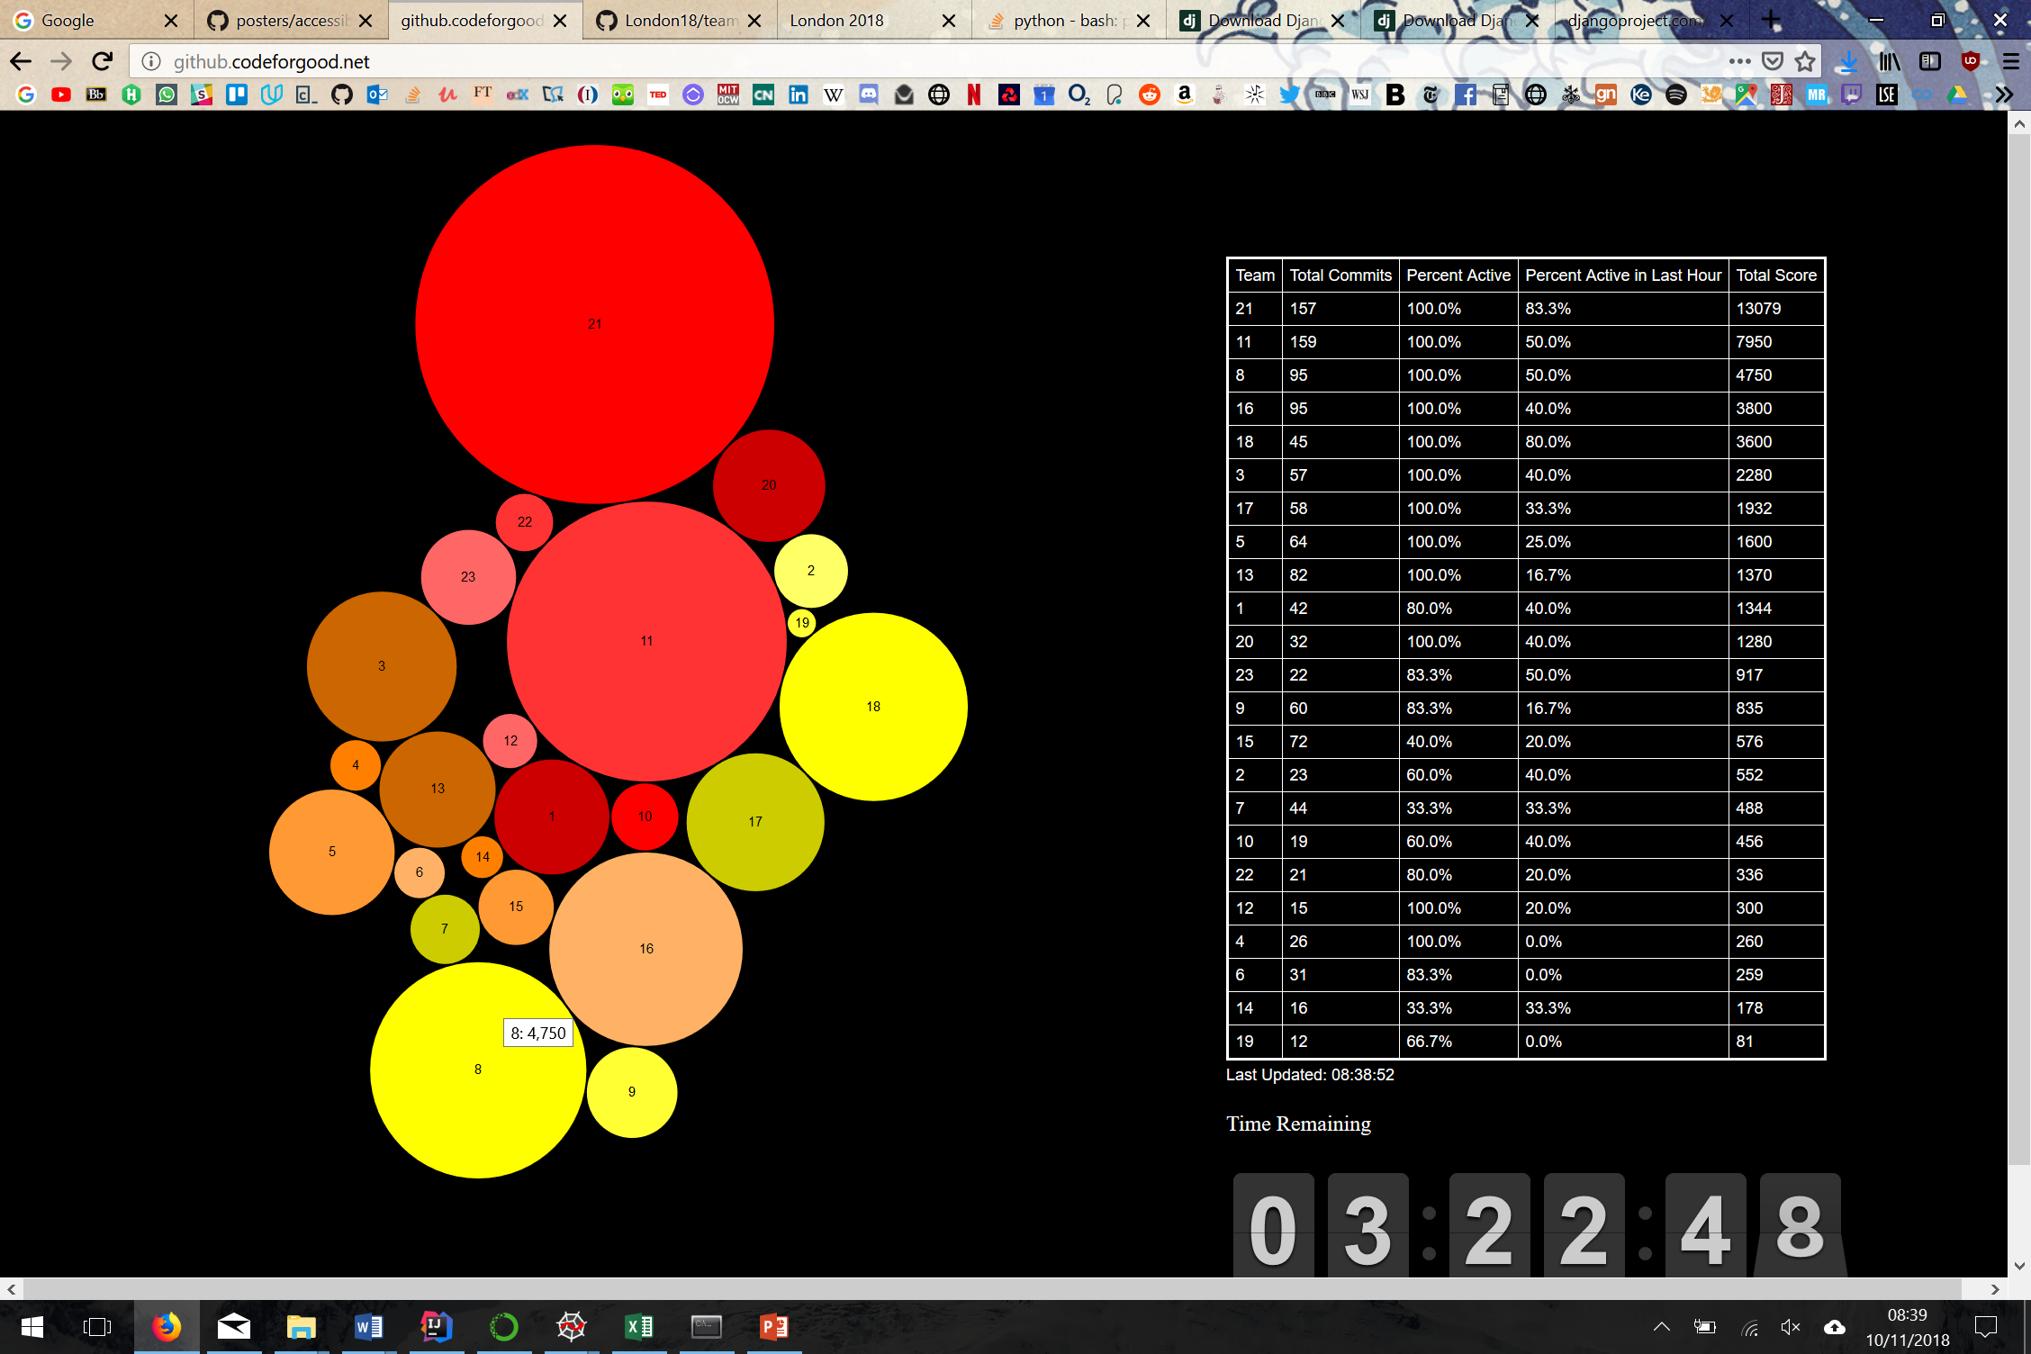
Our Accreditations and awards
21

Slide 9
What impact do we make?
Prevent misdiagnosis
Have better reach
Engage users better
Provide extremely unique insight into responses

Slide 10
Thank you for listening!

